Slide 1
Balanced accuracy, its variance and credible / bootstrap/ confidence intervals
Ning Li
July 17, 2019

Slide 2

Binary Classification
 | True Class
Predict Class | Positive | Negative | Total
Positive | a (True Positive) | b (False Positive) | a+b
Negative | c (False Negative) | d (True Negative) | c+d
Total | a+c | b+d | n
The data is balanced when true positive number plus false negative number equals to false positive number plus true negative number, i.e., a+c = b+d.
$$Sensitivity=\frac{a}{a+c}$$
$$Specificity=\frac{d}{b+d}$$
$$Overall Accuracy=\frac{a+d}{a+b+c+d}$$
$Balanced Accuracy=\frac{sensitivity+specificity}{2}$ =$\frac{\frac{a}{a+c}+\frac{d}{b+d}}{2}$
Overall accuracy equals to balanced accuracy only when data is balanced. Balanced accuracy is an unbiased indicator when data is unbalanced.

Slide 3
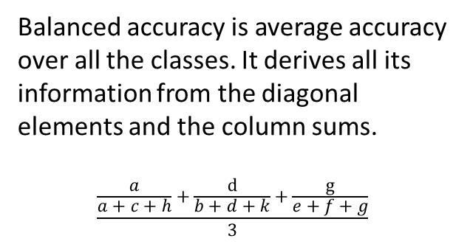
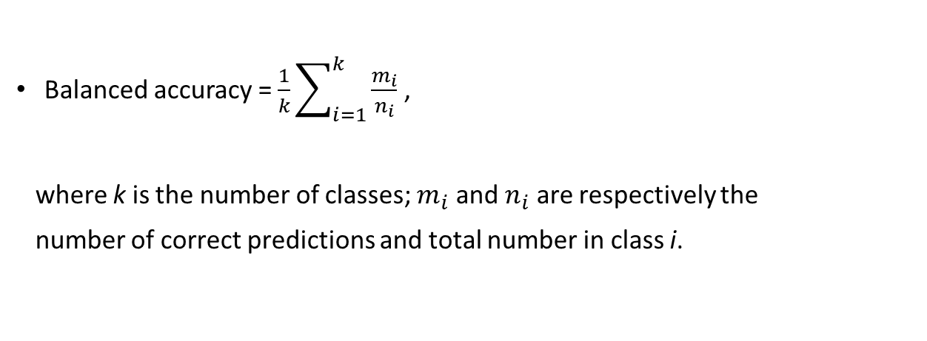
Multiclass Classification
 | True Class
Predict Class | Class 1 | Class 2 | Class 3
Class 1 | a | b | e
Class 2 | c | d | f
Class 3 | h | k | g
Balanced accuracy is average accuracy over all the classes. It derives all its information from the diagonal elements and the column sums.
$$\frac{\frac{a}{a+c+h}+\frac{d}{b+d+k}+\frac{g}{e+f+g}}{3}$$
Balanced accuracy = $\frac{1}{k}\sum_{i=1}^{k}{\frac{m_{i}}{n_{i}}}$ ,
where k is the number of classes; $m_{i}$ and $n_{i}$ are respectively the
number of correct predictions and total number in class i.

Slide 4
Previous research on balanced accuracy
Balanced accuracy is a popular measurement in pattern classification and machine learning, but not well discussed in the filed of statistics
Bayesian credible interval is proposed for balanced accuracy and implemented in Matlab and Python platform.
R function is written to estimate balanced accuracy but there is no R function to calculate confidence interval.

Slide 5
Question?
Bayesian posterior method is a great solution to measure the uncertainty for balanced accuracy but it may face to the challenge from FDA on the prior choice.
Can we construct the confidence interval for balanced accuracy using frequentist method?
Can we estimate the variance of balanced accuracy?

Slide 6
Bootstrap Solution
We focus on calculating interval for binary balanced accuracy
Compromised Bootstrap method
The variance of balanced accuracy is difficult to estimate because the correlation between sensitivity and specificity
should be considered. Thus, bootstrap method seems to be a feasible solution within frequentist school.

Slide 7
Bootstrap idea
“Pulling oneself up by one’s bootstraps” – using the sample data as a population from which repeated samples are drawn.
The population is to the sample as the sample is to the bootstrap samples.
Bootstrap interval construction based on building a sampling distribution for balanced accuracy by resampling from the data at hand.

Slide 8
Bootstrap interval – R function
bacc<- function(data, i) {
d=data[i,]
bacc<-(sensitivity(d$value_pre, d$value_tru)+specificity(d$value_pre, d$value_tru))/2
c(bacc)
}
bacc.boot<-boot(rawdata, bacc, R = 10000)
boot.ci(bacc.boot, conf=0.95, type = c("bca", "norm", "basic", "perc"))
Bias-corrected, accelerated percentile interval is preferable.

Slide 9
Frequentist Solution
Frequentist confidence interval
Any index similar with balanced accuracy that is well discussed in the filed of statistics?

Slide 10

Balanced accuracy vs Youden index
$Youden Index=sensitivity+specificity$-1 = $\frac{a}{ a+c}+\frac{d}{b+d}$ -1
$Balanced Accuracy=\frac{sensitivity+specificity}{2}$ =$\frac{\frac{a}{a+c}+\frac{d}{b+d}}{2}$
Balanced Error Rate (BER) = 1 – Balanced Accuracy
variance of balanced accuracy
= variance of BER
= $\frac{variance of Youden index}{4}$
 | True Class
Predict Class | Positive | Negative
Positive | a | b
Negative | c | d

Slide 11
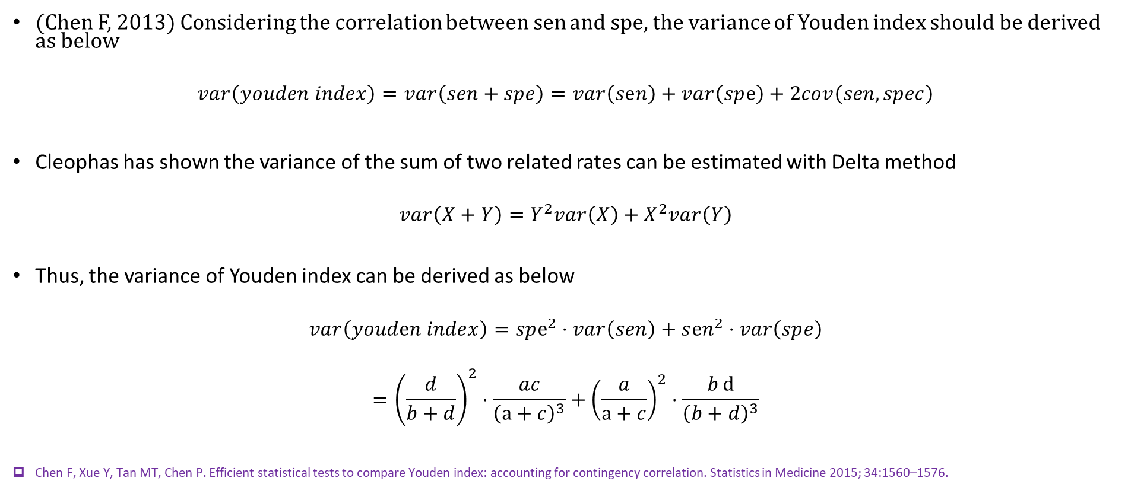
Variance of Youden Index
(Chen F, 2013) Considering the correlation between sen and spe, the variance of Youden index should be derived as below
$$var\left(youden index\right)=var\left(sen+spe\right)=var\left(sⅇn\right)+var\left(spⅇ\right)+2cov\left(sen, spec\right)$$
Cleophas has shown the variance of the sum of two related rates can be estimated with Delta method
$$var\left(X+Y\right)=Y^{2}var\left(X\right)+X^{2}var\left(Y\right)$$
Thus, the variance of Youden index can be derived as below
$$var\left(youdⅇn index\right)=spⅇ^{2}⋅var\left(sen\right)+sⅇn^{2}⋅var\left(spⅇ\right)$$
$$={\left(\frac{d}{b+d}\right)}^{2}⋅\frac{ac}{{\left(a+c\right)}^{3}}+{\left(\frac{a}{a+c}\right)}^{2}⋅\frac{bⅆ}{{\left(b+d\right)}^{3}}$$
Chen F, Xue Y, Tan MT, Chen P. Efficient statistical tests to compare Youden index: accounting for contingency correlation. Statistics in Medicine 2015; 34:1560–1576.

Slide 12
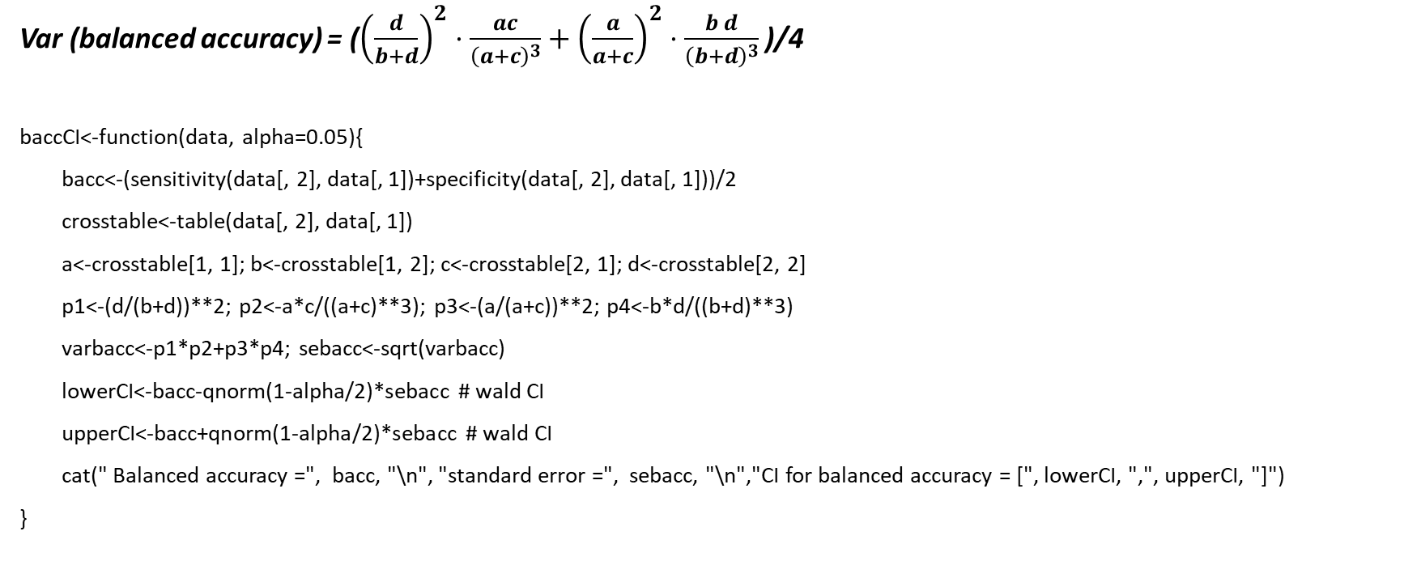
Frequentist confidence interval – R function
Var (balanced accuracy) = (${\left(\frac{d}{b+d}\right)}^{2}⋅\frac{ac}{{\left(a+c\right)}^{3}}+{\left(\frac{a}{a+c}\right)}^{2}⋅\frac{bⅆ}{{\left(b+d\right)}^{3}}$ )/4
baccCI<-function(data, alpha=0.05){
bacc<-(sensitivity(data[, 2], data[, 1])+specificity(data[, 2], data[, 1]))/2
crosstable<-table(data[, 2], data[, 1])
a<-crosstable[1, 1]; b<-crosstable[1, 2]; c<-crosstable[2, 1]; d<-crosstable[2, 2]
p1<-(d/(b+d))**2; p2<-a*c/((a+c)**3); p3<-(a/(a+c))**2; p4<-b*d/((b+d)**3)
varbacc<-p1*p2+p3*p4; sebacc<-sqrt(varbacc)
lowerCI<-bacc-qnorm(1-alpha/2)*sebacc # wald CI
upperCI<-bacc+qnorm(1-alpha/2)*sebacc # wald CI
cat(" Balanced accuracy =", bacc, "\n", "standard error =", sebacc, "\n","CI for balanced accuracy = [", lowerCI, ",", upperCI, "]")
}

Slide 13
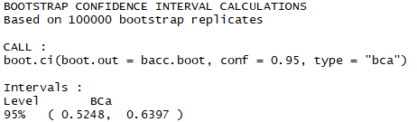
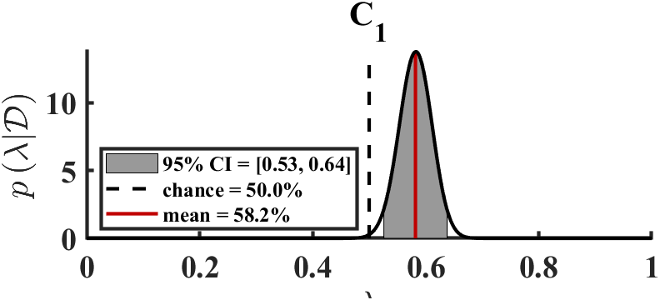
Hypothetical Data Example
 | Disease
Test | Positive | Negative | Total
Positive | 80 | 40 | 120
Negative | 80 | 80 | 160
Total | 160 | 120 | 280
Among the three methods, Bayesian method provides the narrowest CI, followed by bootstrap method and frequentist method. Frequentist provides the widest CI as it strictly considers the correlation between sensitivity and specificity, however, correlation is ignored in Bayesian credible interval which is derived from convolution of two beta distributions

Slide 14
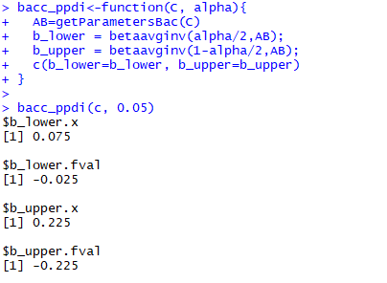
Bayesian credible interval
Henry Carrillo uses Fourier transforms of class-specific performance distributions to obtain a posterior distribution that can be used to evaluate and compare competing classifiers. To facilitate its use, they provide an open-source MATLAB implementation
https://mloss.org/software/view/447/
Python package “mclearn” (Cheng Soon Ong)
https://pythonhosted.org/mclearn/performance.html.
https://github.com/chengsoonong/mclass-sky
R package “micp” (Kay H Brodersen)
This package is not available in the website.
Re-write matlab codes in R platform
It produces wrong intervals (code validation)
Brodersen KH, Ong CS, Stephan KE, Buhmann JM.The Balanced Accuracy and Its Posterior Distribution. In: Pattern Recognition (ICPR), 2010 20th International Conference on. (Aug. 2010) 3121 – 3124
Carrillo H, Brodersen KH, Castellanos JA. Probabilistic performance evaluation for multiclass classification using the posterior balanced accuracy. ROBOT'13, 28 - 29 November 2013, Madrid, Spain, pp 347-361.

Slide 15
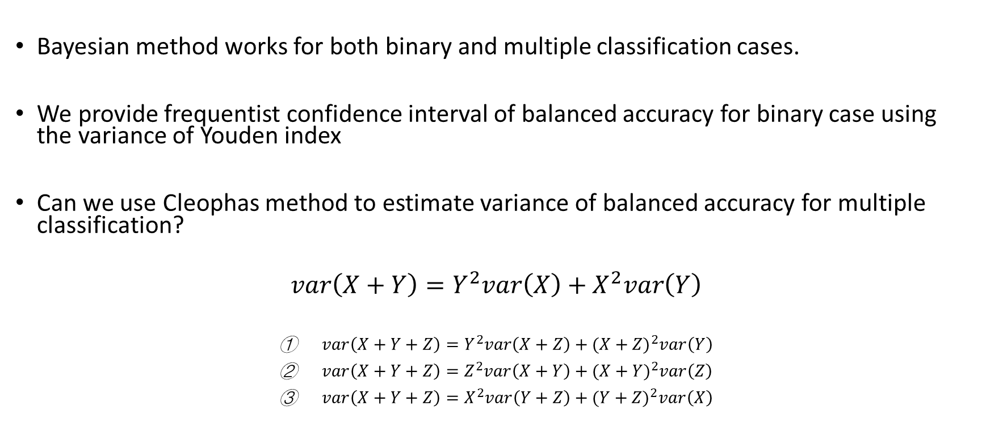
Discussion
Bayesian method works for both binary and multiple classification cases.
We provide frequentist confidence interval of balanced accuracy for binary case using the variance of Youden index
Can we use Cleophas method to estimate variance of balanced accuracy for multiple classification?
$$var\left(X+Y\right)=Y^{2}var\left(X\right)+X^{2}var\left(Y\right)$$
$var\left(X+Y+Z\right)=Y^{2}var\left(X+Z\right)+{(X+Z)}^{2}var\left(Y\right)$
$var\left(X+Y+Z\right)=Z^{2}var\left(X+Y\right)+{(X+Y)}^{2}var\left(Z\right)$
$var\left(X+Y+Z\right)=X^{2}var\left(Y+Z\right)+{(Y+Z)}^{2}var\left(X\right)$

Slide 16
One Methodology?
Ian Hacking (1983)
There is not just one way to build a house, or even to grow tomatoes. We should not expect something as motley as the
growth of knowledge (statistics) to be strapped to one methodology.
Bayesian Credible Interval (Prior choice)
Frequentist Confidence Interval (Not probability interval)
Fisherian Fiducial Interval (to estimate interval in frequentist school in the style of a Bayesian posterior)
Confidence Distribution Method (Xie & Singh, 2013): bootstrap distributions are “distribution estimators” and “confidence distributions”
Inferential Model (Matin & Liu, 2013)
Martin R, Liu C. Inferential models: a framework for prior-free posterior probabilistic inference. Journal of the American Statistical Association 2013. 108, 301-313.
Xie M, Singh, K. Confidence distribution, the frequentist distribution of a parameter – a review. International Statistical Review 2013, 81, 1, 3–39

